Slide 1
Diyala University College of Engineering Fourth Year 2012/2013 Computer & Software Engineering Department
Public Key Cryptography
Chapter 3/Part2
PRESENTED BY
DR. ALI J. ABBOUD

Slide 2
3.1 Objectives
Prime Numbers.
Fermat’s and Euler’s Theorems.
Testing for Primarily.
Discrete Logarithm
Diffie-Hellman Key Exchange Algorithm.
Security of Diffie-Hellman Algorithm.
Key Exchange Protocols.
Man-in-the-Middle Attacks.
ElGamal Cryptosystem.
Security of ElGamal Cryptosystem.

Slide 3
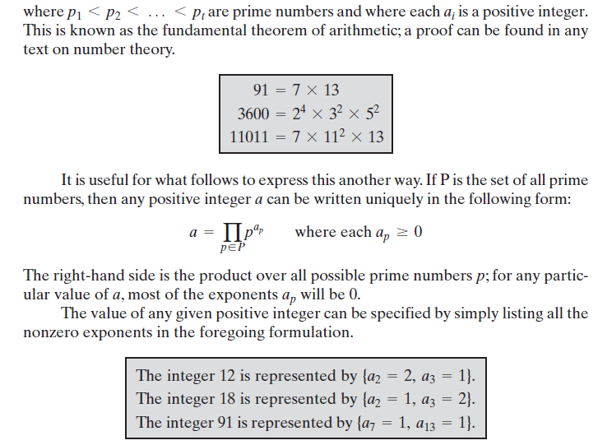
3.2 Prime Numbers

Slide 4
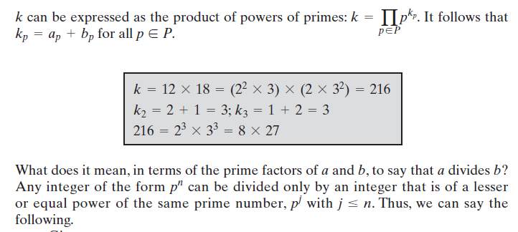
3.2 Prime Numbers

Slide 5
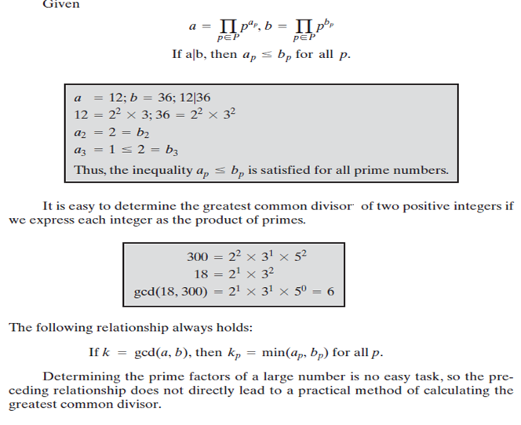
3.2 Prime Numbers

Slide 6
3.3 FERMAT’S AND EULER’S THEOREMS

Slide 7
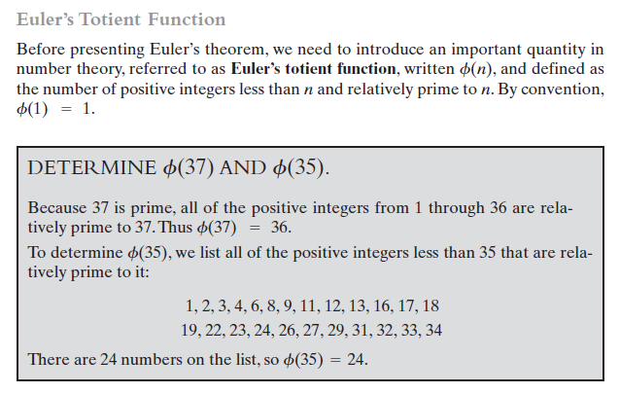
3.3 FERMAT’S AND EULER’S THEOREMS

Slide 8
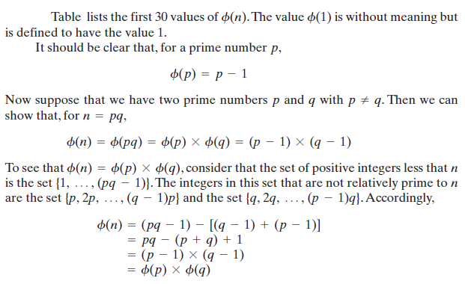
3.3 FERMAT’S AND EULER’S THEOREMS

Slide 9
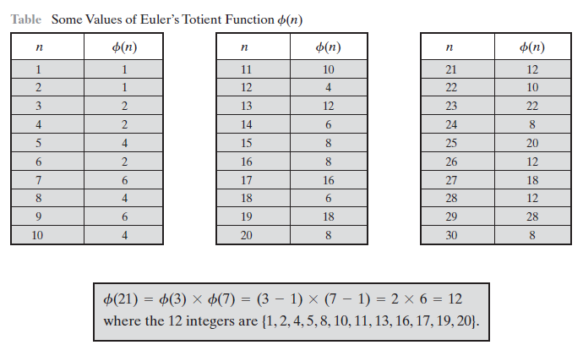
3.3 FERMAT’S AND EULER’S THEOREMS

Slide 10
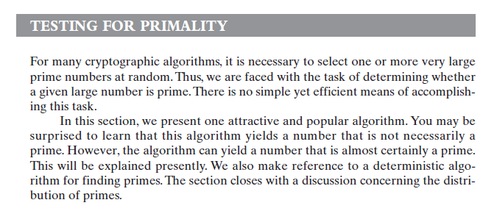
3.3 FERMAT’S AND EULER’S THEOREMS

Slide 11
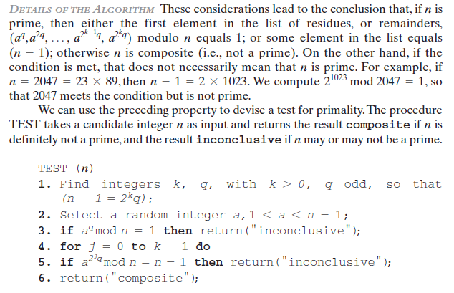
3.4 Testing For Primarlity

Slide 12
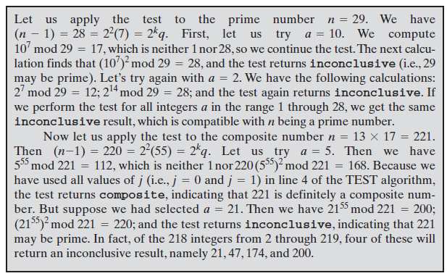
3.4 Testing For Primarlity

Slide 13
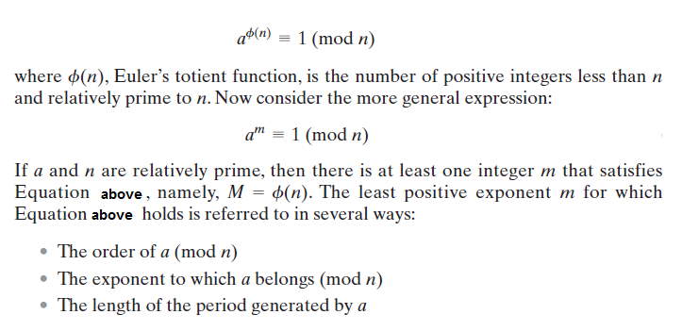
3.5 Discrete Logarithm

Slide 14
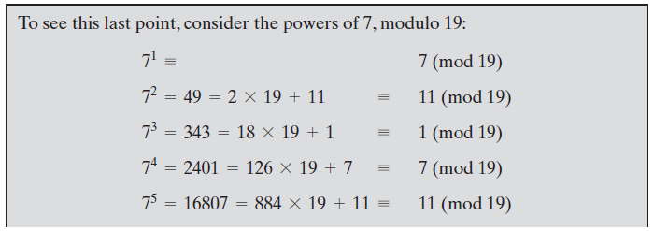
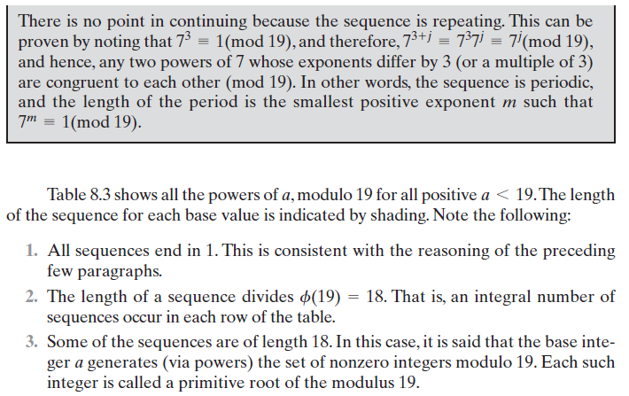
3.5 Discrete Logarithm

Slide 15
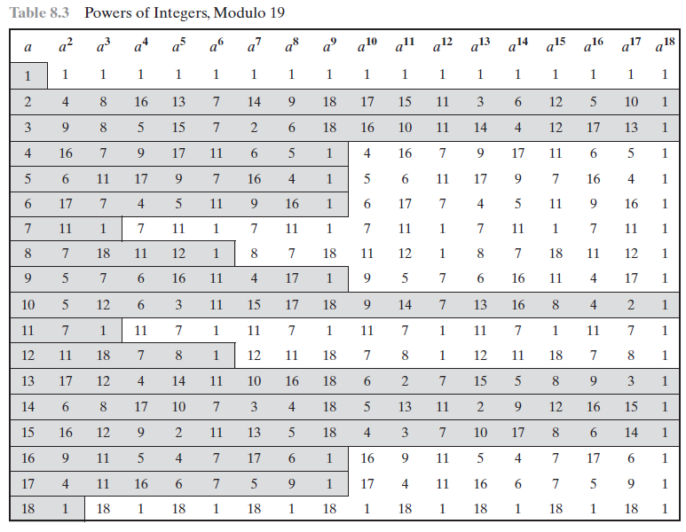
3.5 Discrete Logarithm

Slide 16
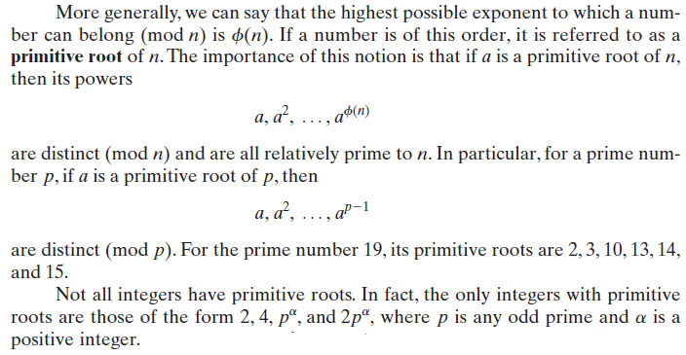
3.5 Discrete Logarithm

Slide 17
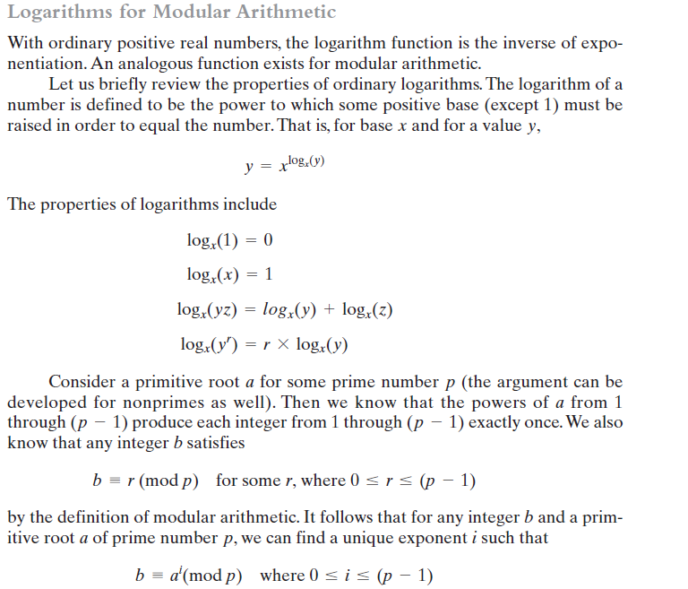
3.5 Discrete Logarithm

Slide 18
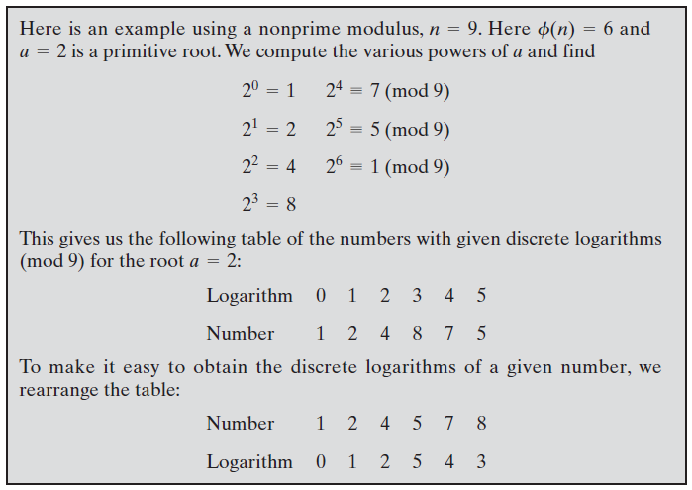
3.5 Discrete Logarithm

Slide 19
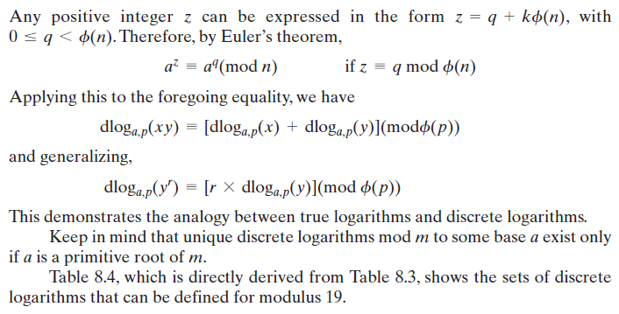
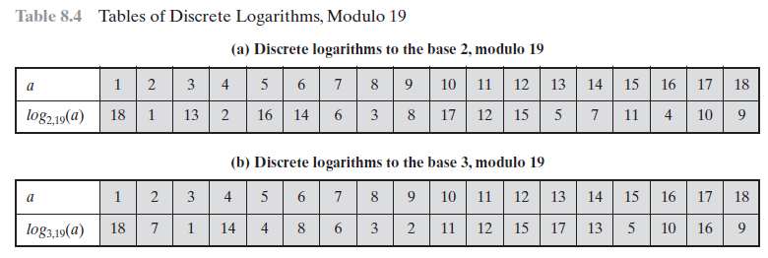
3.5 Discrete Logarithm

Slide 20
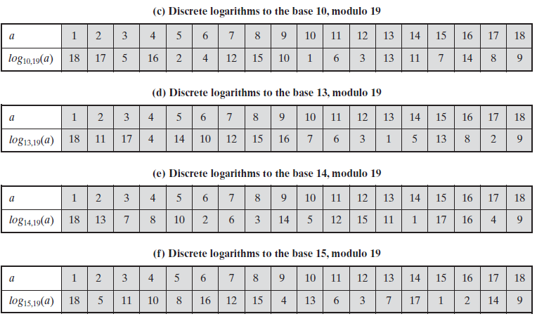
3.5 Discrete Logarithm

Slide 21
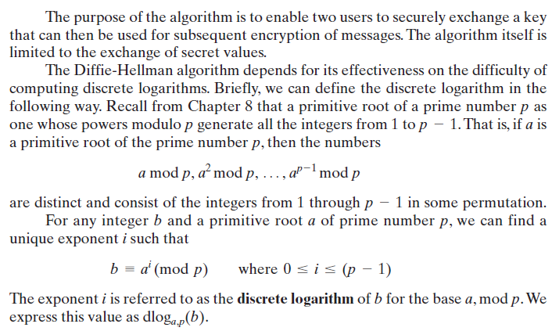
3.6 Diffie-Hellman Key Exchange Algorithm

Slide 22
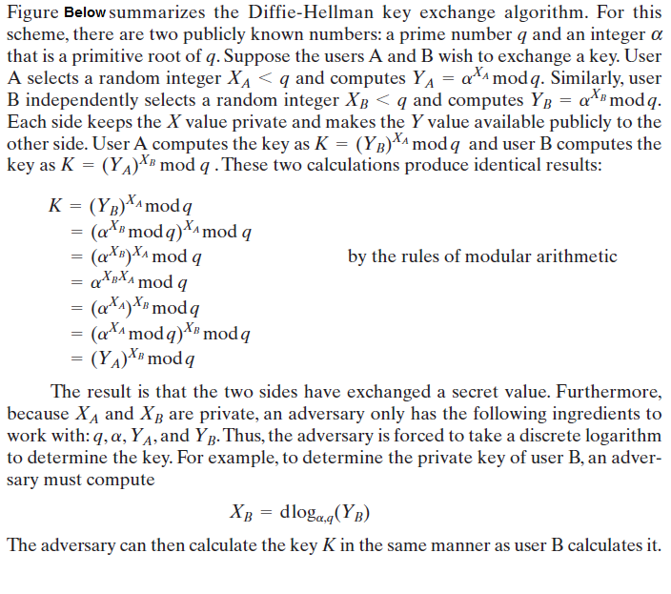
3.6 Diffie-Hellman Key Exchange

Slide 23
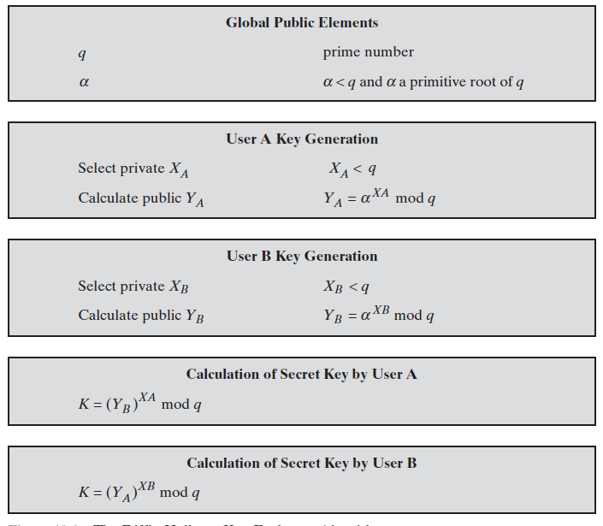
3.6 Diffie-Hellman Key Exchange

Slide 24
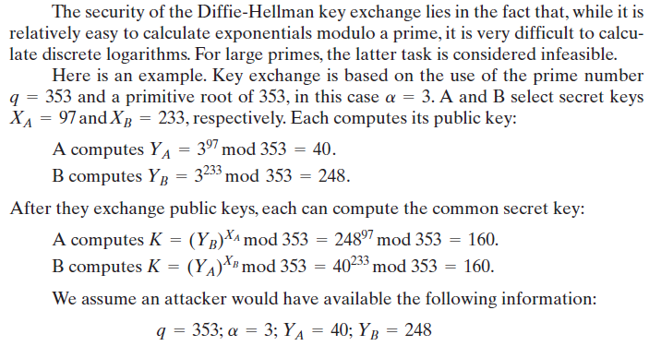
3.7 Security of Diffie-Hellman Key Exchange

Slide 25
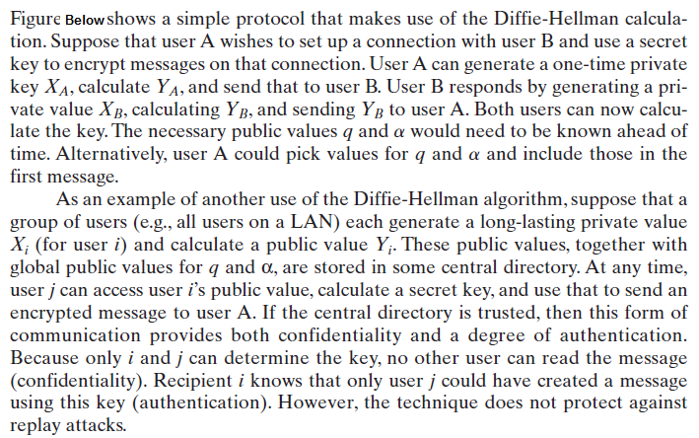
3.8 Key Exchange Protocols

Slide 26
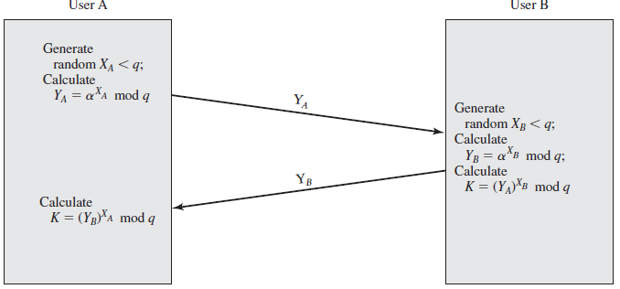
3.8 Key Exchange Protocols

Slide 27
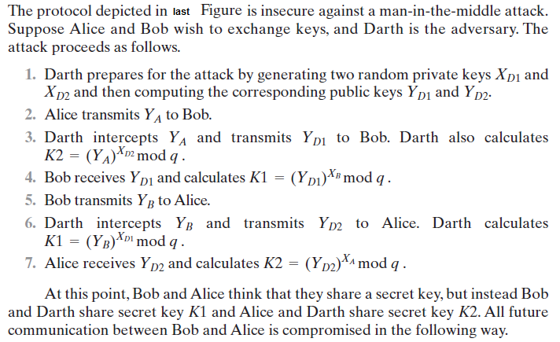
3.8 Man-in-the-Middle Attacks

Slide 28
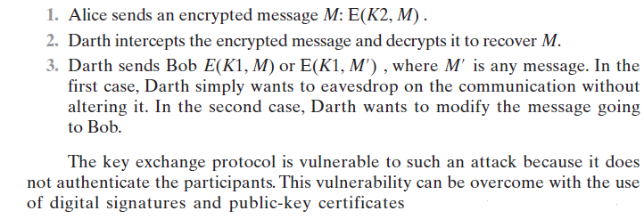
3.8 Man-in-the-Middle Attacks

Slide 29
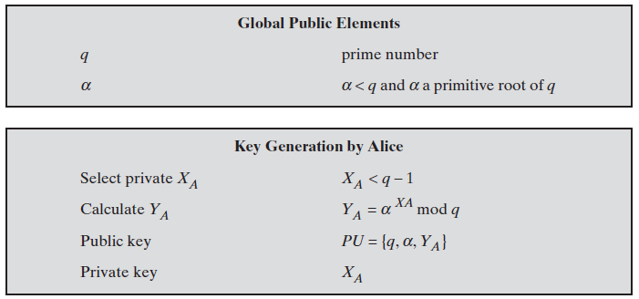
3.9 ElGamal Cryptosystem

Slide 30
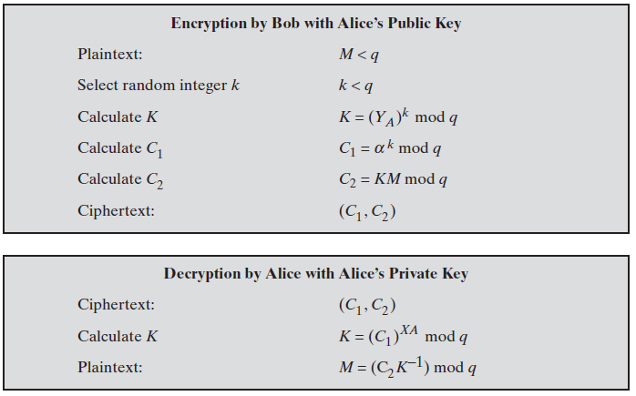
3.9 ElGamal Cryptosystem

Slide 31
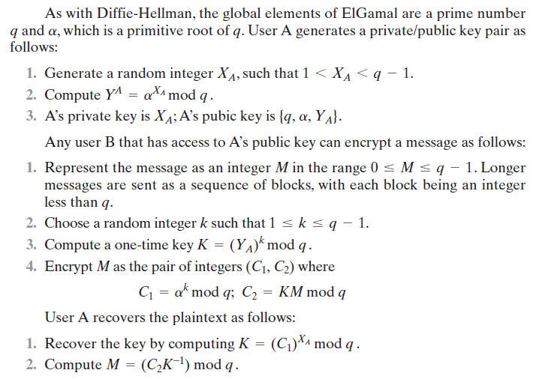
3.9 ElGamal Cryptosystem

Slide 32
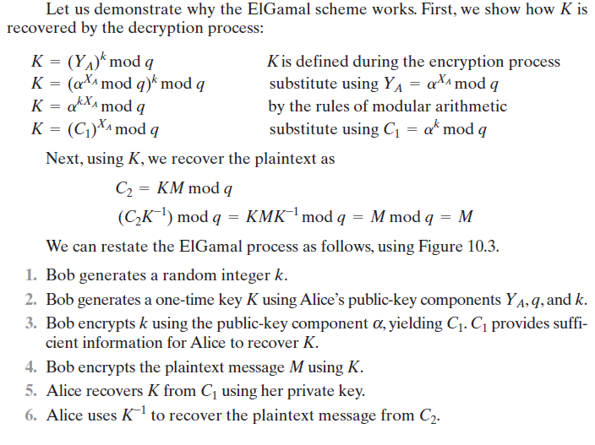
3.9 ElGamal Cryptosystem

Slide 33
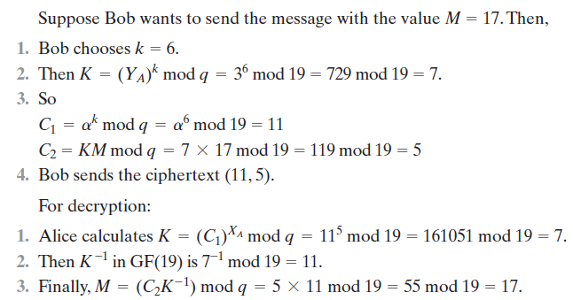
3.9 ElGamal Cryptosystem

Slide 34
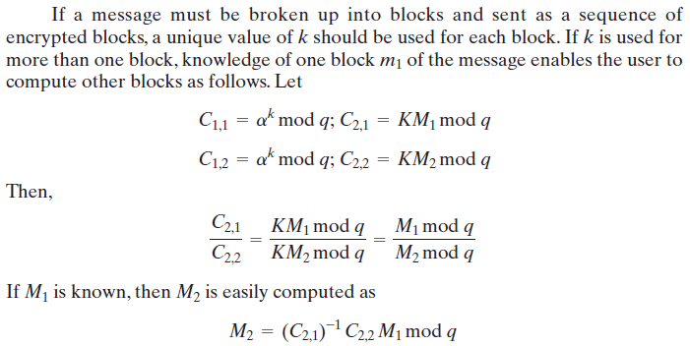
3.9 ElGamal Cryptosystem

Slide 35
3.10 Security of ElGamal Cryptosystem
The security of ElGamal is based on the difficulty of computing discrete logarithms.
To recover A’s private key, an adversary would have to compute
Alternatively, to recover the one-time key , an adversary would have to determine the random number k, and this would require computing the discrete logarithm .
It points out that these calculations are regarded as infeasible if is at least 300 decimal digits and has at least one “large” prime factor.

Slide 36
End of Chapter 3/Part2

